Slide 1

Welcome Back
Lab 4-
Website Promotion and driving traffic to your page

Slide 2
Lab 4
Expectations
Chat Support Available During Webinars
Knowing Your Resources
Webinar Process
Facebook Support
Search: Crexendo UP Website Competition
Online Resources
up.Crexendo.com/unr

Slide 3
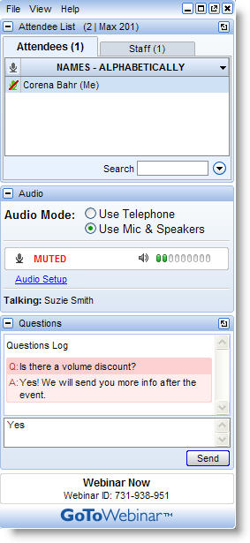
Lab 4
Live presentation
Attendees are muted
Type your questions in the “Questions” window
Questions answered live or via chat reply

Slide 4
Lab 4 Review
Webinar 3 Review
SEO Keyword Map
Categorizing Keywords
Copy
Domains
Designs (Layouts)
Schemes
CRO Header
Pages
    Layers
Elements
Q&A

Slide 5
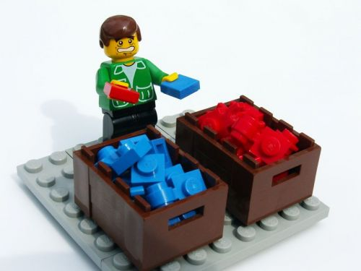
Lab 4
Webinar 3 Review
SEO Keyword Map
Categorizing Keywords
Copy
Domains
  SEO Keyword Map
    Take Green Competition
    Insert in SEO Keyword Map
Q&A
  Categorize them into groups of similar keywords
Notes:
Click over to keyword map and show how to complete the Categorization.

Slide 6
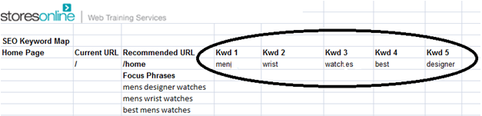
Lab 4
Webinar 3 Review
SEO Keyword Map
Categorizing Keywords
Copy
Domains
  Take one group and place under “focus phrases” on SEO Keyword Map
  Separate the individual words from the focus phrases to get the Keywords to focus on for each page.
Q&A

Slide 7

Lab 4
Webinar 3 Review
SEO Keyword Map
Categorizing Keywords
Copy
Domains
Search Engines
Site Visitors
What do search engines want?
Keyword Density
300-500 words
Be about something
2-4%
Q&A
Textalyser.net

Slide 8

Lab 4
Webinar 3 Review
SEO Keyword Map
Categorizing Keywords
Copy
Domains
What do Visitors Want?
What the words say
  Write clear and to the point.
  Answer their question
  An active voice.
  Appeal to emotion
  Include a call to action
WHY BUY HERE?
Q&A

Slide 9
Lab 4
Webinar 3 Review
SEO Keyword Map
Categorizing Keywords
Copy
Domains
What do Visitors Want?
How the words are formed.
  Skimmability
  Add $%*@ to the text
Q&A

Slide 10
Lab 4
Webinar 3 Review
SEO Keyword Map
Categorizing Keywords
Copy
Domains
What makes up a great domain name?
  Place keywords in domain name
Registering a Domain
Purchasing a Domain
www.domainname.com
Q&A

Slide 11

Lab 4
Webinar 3 Review
SEO Keyword Map
Categorizing Keywords
Copy
Domains
Questions
Answers
Q&A

